Slide 1
EXERCISE 6.3 SEMANTIC TABLEAUX
Gligor Ovidiu -Group 913

Slide 2
;
Using the semantic tableaux method check whether the following logical consequences holds.

Slide 3
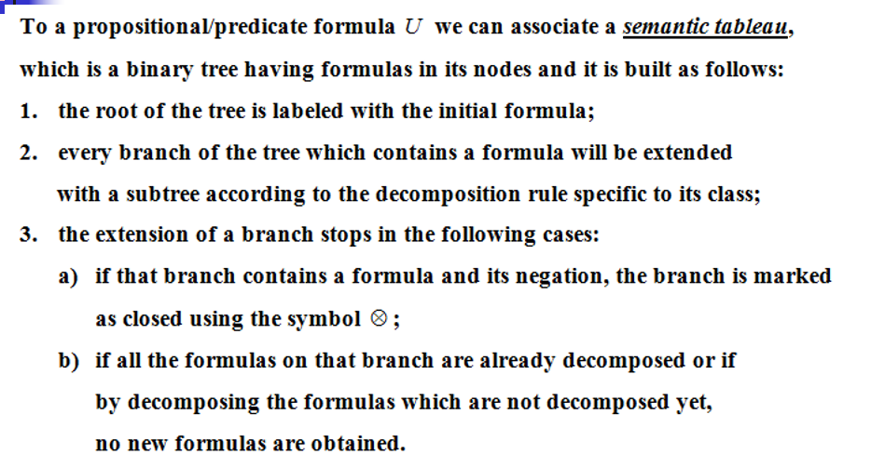

Slide 4
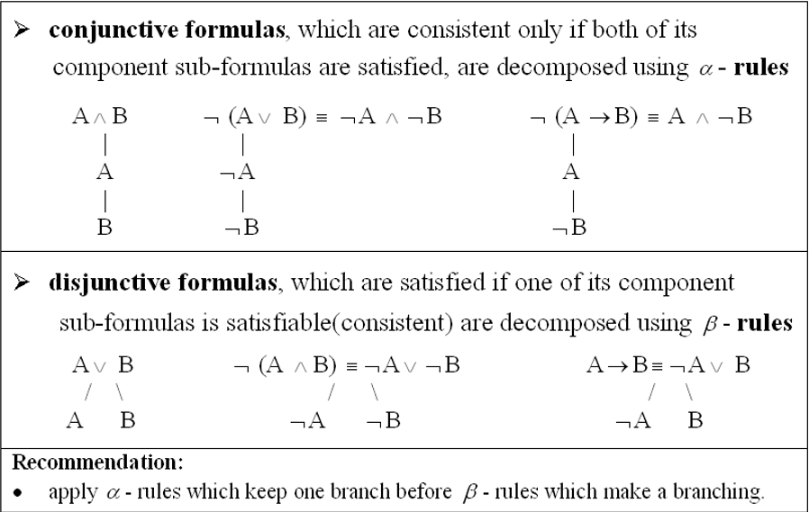

Slide 5
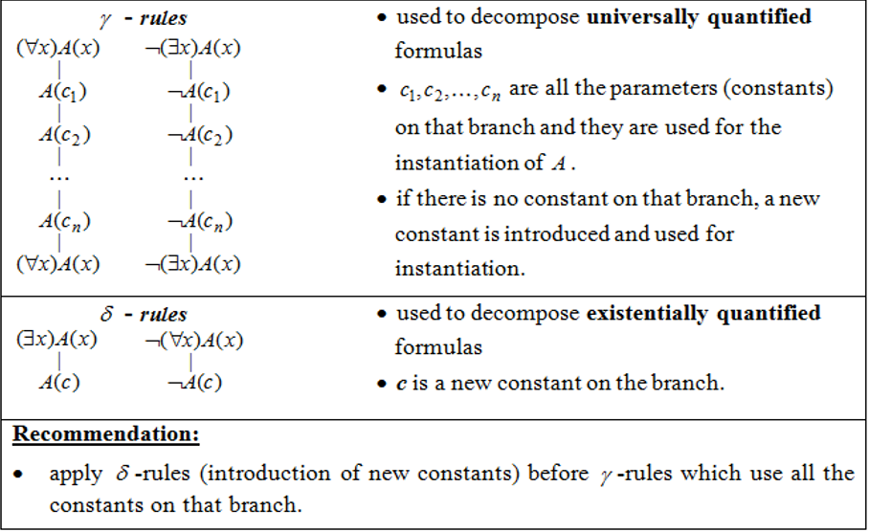

Slide 6
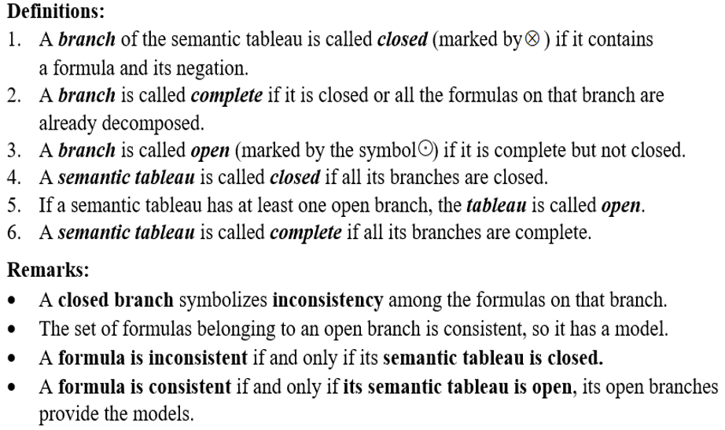

Slide 7
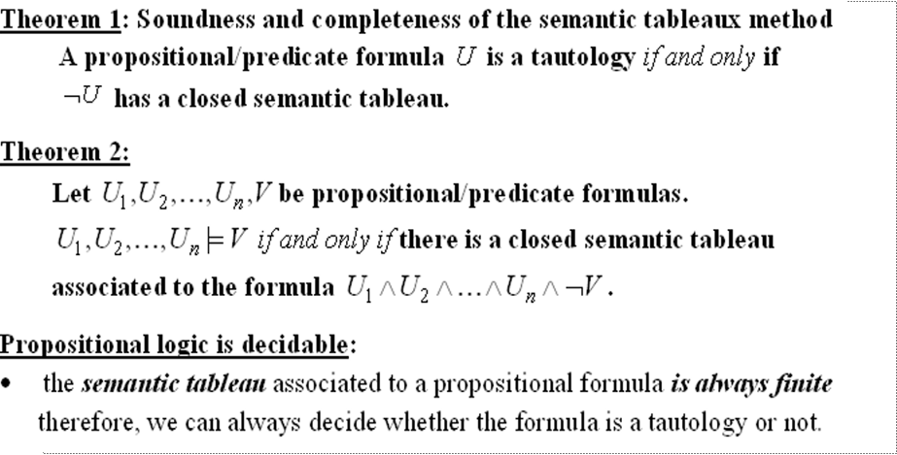
THEORETICAL RESULTS

Slide 8
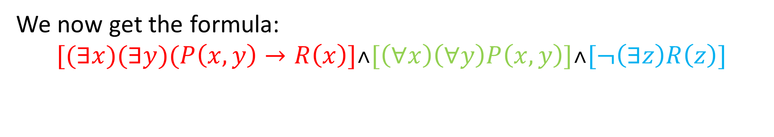

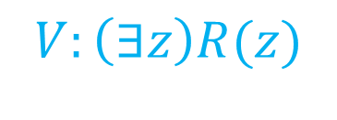

$$U_{1}:(∃x)(∃y)(P\left(x,y\right)→R\left(x\right))$$
$$U_{2}:\left(∀x\right)\left(∀y\right)P\left(x,y\right)$$
$$V:\left(∃z\right)R(z)$$
We now get the formula:
$$[(∃x)(∃y)(P\left(x,y\right)→R\left(x\right)]˄[\left(∀x\right)\left(∀y\right)P\left(x,y\right)]˄[¬\left(∃z\right)R\left(z\right)]$$

Slide 9

$$[(∃x)(∃y)(P\left(x,y\right)→R\left(x\right)]˄[\left(∀x\right)\left(∀y\right)P\left(x,y\right)]˄\left[¬\left(∃z\right)R\left(z\right)\right] (1)$$
| α rule for (1)
$(∃x)(∃y)(P(x,y)→R\left(x\right) (2)$
|
$\left(∀x\right)\left(∀y\right)P\left(x,y\right) (3)$
|
$¬\left(∃z\right)R\left(z\right) (4)$
| δ rule for (2) c1-new constant
$(∃y)(P(c1,y)→R\left(c1\right) (5)$
| δ rule for (5) c2-new constant
$P\left(c1,c2\right)→R\left(c1\right) \left(6\right)$
| β rule for (6)
/ \
$¬P\left(c1,c2\right) R\left(c1\right)$
| |
$\left(∀x\right)\left(∀y\right)P\left(x,y\right) copy of \left(3\right) ¬\left(∃z\right)R\left(z\right) copy of (4)$
| γ rule for (3) | γ rule for (4)
$(∀y)P\left(c1,y\right) ¬R(c1)$
| γ rule for (3) | γ rule for (3)
$P(c1,c2) ¬R(c2)$
⦻ ⦻

Slide 10
CONCLUSION
The logical consequence
holds.

